Slide 1
Reference Books for the slides
1) Introduction to Data Mining
Author: P N Tan, M Steinbach and V Kumar
2) Data Mining: Concepts and Techniques
Author: J Han and M Kamber

Slide 2
Classification
It is the task of assigning objects to one of several predefined categories,
e.g., Detecting spam email messages based upon the message header and content
Input Output
Fig. 1: A schematic illustration of a classification task.
It is the task of learning a target function f that maps each attribute set x to one of the predefined class labels, y.
Classification Model
Attribute set
(x)
Class label
(y)

Slide 3
Types
1. Descriptive modeling
2. Predictive modeling
Descriptive modeling
- A classification model can serve as a tool to distinguish between objects of different classess.
Predictive modeling
A classification model can also be used to predict the class label of unknown records.
Example
- Classify a person as a high, medium or low income group

Slide 4
Table 4.1: Mammal classification
Name | Body temp | Skin cover | Gives birth | Aquatic creature | Aerial creature | Has legs | Hibernates | Class label
Human | Warm-blooded | Hair | Yes | No | No | Yes | No | Mammal
Python | Cold-blooded | Scales | No | No | No | No | Yes | Reptile
Salmon | Cold-blooded | Scales | No | Yes | No | No | No | Fish
… | …. | … | … | … | … | … | … | …

Slide 5
General approach for building a classification model
A classification technique or a classifier is a systematic approach to building classification models from an input data set.
E.g. decision tree classifiers, rule-based classifiers, neural networks etc.
Each technique employs a learning algorithm to identify a model
Fig. 4.3

Slide 6
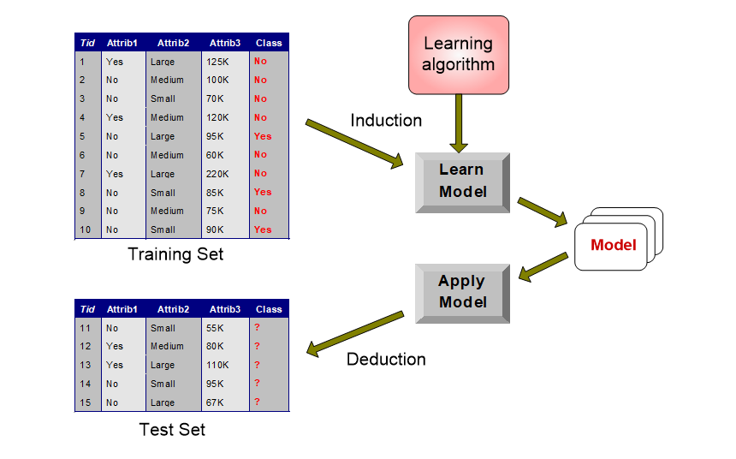

Slide 7
Decision tree Induction
A decision tree is a hierarchical structure consisting of nodes and directed edges.
E.g., Fig. 4.4
The tree has 3 types of nodes:
  Root
  Internal nodes
  Leaf or terminal nodes
Each leaf node is assigned a class label. The non-terminal nodes (root, internal nodes) contain attribute test conditions to separate records that have different characteristics
Classifying a test record is easy once a decision tree has been constructed

Slide 8
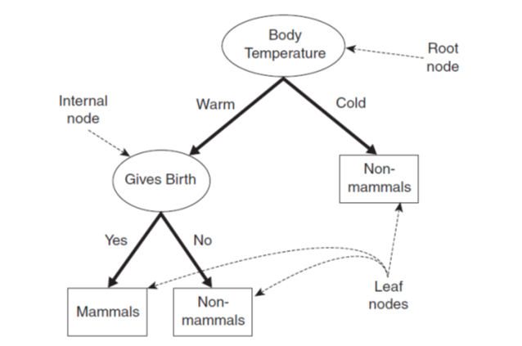
Starting at the root (based on information gain), we apply the test condition to the record and follow the appropriate branch based on the outcome of the test.
This will result another internal node (based on information gain), for which a new test condition is applied, or to a leaf node.

